Slide 1

Mini Project First Review Presentation on Water Quality Detection using Machine Learning
SIDDAGANGA INSTITUTE OF TECHNOLOGY, TUMKUR
Department of Information Science and Engineering
Under the guidance of:
Mrs. Sharmila S P
Asst. Professor
Dept. of ISE, SIT, Tumkur
By
Balaji E S :1SI19IS013
Deepak K :1SI19IS017
Tejas S :1SI19IS064

Slide 2
Outline
Introduction
Objective/Aim
Literature Survey
Proposed Work
System Architecture
Flow diagram
Requirements
Applications
Conclusion
References
Dept. of ISE, SIT, Tumkur
2

Slide 3
INTRODUCTION
Introduction
Water is the most significant resource of life, crucial for supporting the life of most existing creatures and human beings.
Water is used for various practices, such as drinking, agriculture, household and recreational activities, hydroelectric power generation, industries etc.
Over the years due to deterioration of water quality due to industrialization, one of the world’s primary concerns has been the protection and quality of water.
Only 2% of the worlds water resources are fresh water supplies which are getting polluted as a result of human activity.
Dept. of ISE, SIT, Tumkur
3

Slide 4
Introduction
INTRODUCTION
By advancing soft computing techniques in most areas of water and environmental engineering, researchers have attempted to accurately analyze time series of water quality components and their internal relation.
Machine learning algorithms have proven themselves as a universal tool for different types of tasks, including water quality detection, giving advanced possibilities for dealing with analyzed data using data imputation, classification and regression.
The results shows high accuracy in predicting the quality of water, based on the algorithms with real datasets providing an alternative to the traditional laboratory approaches.
Dept. of ISE, SIT, Tumkur
4

Slide 5
OBJECTIVE
Objective
The goal of our mini project is to analyze Indian water quality data to develop an accurate machine learning model to predict water quality efficiently and accurately.
A water quality index (WQI) is a numeric expression used to evaluate the quality of a given water body.
The WQI values ranges between 0 and 100, with 100 representing the highest quality.
The formulation of the WQI involves a series of steps that include :
Developing mathematical equations called Indices based on observed water quality parameters
Applying a suitable averaging formula to arrive at a single numeric value.
Dept. of ISE, SIT, Tumkur
5

Slide 6
OBJECTIVE
Objective
Normally water quality must be defined based on a set of chemical variables that are closely related to the water’s intended use.
For each variable, acceptable and unacceptable values must be defined.
Water whose variables meet the pre-established standards for a given use is considered as “acceptable”. If the water fails to meet these standards, it must be treated before use.
Finally the objective is to validate the performance of predictive models using different evaluation metrics and identify the best predictive model for our project (Water Quality Detection).
Dept. of ISE, SIT, Tumkur
6

Slide 7
Literature Survey
[1] A survey of Machine Learning methods applied to Anomaly detection of drinking-water quality data
(Published Year: 19 Jul 2019)
Description:
Support Vector Machine (SVM), Logistic Regression (LR) and Artificial Neural Networks (ANN) are the traditional ML methods that have gained most attention recently in Water Quality Detection and Anomaly detection.
Apart from these traditional ML methods, statistical methods are also trusted for Anomaly detection of Water Quality data. Multivariate techniques such as Principal Component Analysis and Linear Discriminant Analysis have also been applied in their area of study.
LITERATURE SURVEY
Dept. of ISE, SIT, Tumkur
7

Slide 8
LITERATURE SURVEY
Literature Survey
Deep Learning is a type of Machine Learning based on Artificial Neural Networks in which multiple layers of processing are used to extract progressively higher-level features from data.
It plays an important role to investigate other novel Anomaly Detection techniques to improve performance and overcome the shortcomings of Traditional methods.
ML techniques like SVM produces good results for Water Quality Detection tasks and good prospects by using hybrid DL model for Anomaly Detection tasks.
Conclusion:
This hybrid DL-SVM method, predicts Water Quality efficiently but if
the dataset is too large the accuracy may be less.
Dept. of ISE, SIT, Tumkur
8

Slide 9
Literature Survey
[2] Efficient Water Quality Detection using Machine learning
K-means Algorithm
(Published Date: 24 October 2020)
Description:
Machine learning in Water Quality monitoring where the Water Quality parameters are analyzed and predicted based on the K Means algorithm.
K means is Unsupervised Learning model which analyses the data with the help of training data sets which produces an output of Hyperplane which separates the new inputs.
Various sorts of water are taken as preparing sets which incorporate Mud water, Lemon water, Saltwater, Tap water and Drinking water.
LITERATURE SURVEY
Dept. of ISE, SIT, Tumkur
9

Slide 10
LITERATURE SURVEY
Literature Survey
The new data sets that is to be predicted, that have similar pH, Conductivity and Turbidity value fall on to the same category of Cluster.
All the Water Quality values that are trained during the training period are clustered in a way that each Cluster in the network represents a detailed kind of water like Mud water, Lemon water, Salt water, Tap water and Drinking water.
Conclusion:
Alone K-means Algorithm will give a good results but on comparing
with other ML Algorithms the Accuracy rate may be not great. But the
Dataset plays important role in any prediction algorithm.
Dept. of ISE, SIT, Tumkur
10

Slide 11
LITERATURE SURVEY
Literature Survey
[3]Water Quality Prediction Using Artificial Intelligence Algorithm
Published on : November 2020
Description
In this survey, Neural network structure is used for modelling complex non-linear relationships, especially where the exact relationship between the variables is unknown.
This is a very powerful and reliable computational technique with the ability of treating complicated and non-linear problems.
They include a simple and highly interconnected processor known as the Neuron.
This Neuron is essential to the operations of a neural network as the hub for Information processing.
ANN can deal with incomplete data and approximate results. They are not susceptible to outliers and are highly parallel.
Dept. of ISE, SIT, Tumkur
11

Slide 12
LITERATURE SURVEY
Literature Survey
The use of ANN in problem solving does not need a prior knowledge of the underlying process which is a well known advantage.
ANN recognizes the existing complex relationships during the course of the investigations and always converges to get an optimal condition.
The developments of these models usually undergo different steps which are:
1. The choice determination of criteria for examining performance.
2. Dividing the available data into segments and it’s Pre-processing.
3. The model inputs determination for appropriateness and the Architecture of the Network
4. The connection weights optimization.
5. Validation of the models
Conclusion:
The prediction of surface water quality variables will consider the use of a hybrid
model of ANN to ensure the Linearity and Non-Linearity of the data is adequately
covered.
Dept. of ISE, SIT, Tumkur
12

Slide 13
Literature Survey
[4] Water Quality classification by integration of attribute-realization and Support Vector Machine for river water,
Journal of Ecology Engineering
(Published on: 24 October 2020)
Description:
In this Survey machine learning-based approach integrating attribute-realization (AR) and Support Vector Machine (SVM) algorithm to classify the River’s Water Quality.
The AR has determined the most significant factors to improve the river’s quality
In the categorization, the most contributing characteristics were: NH₃ , Biological Oxygen Demand, Dissolved Oxygen boosting the contributed values in the range of 0.80–0.98.
LITERATURE SURVEY
Dept. of ISE, SIT, Tumkur
13

Slide 14
LITERATURE SURVEY
Literature Survey
The SVM Linear method has enabled the best classification results represented as the accuracy of 0.94, a precision average of 0.84
Conclusion:
With the F1-score average of 0.84, the validation showed that
AR-SVM was a powerful method to identify River Water Quality with
0.86–0.95 accuracy when applied to three to six characteristics.
Therefore, This Algorithm perform very efficiently to give good
Accuracy.
Dept. of ISE, SIT, Tumkur
14

Slide 15
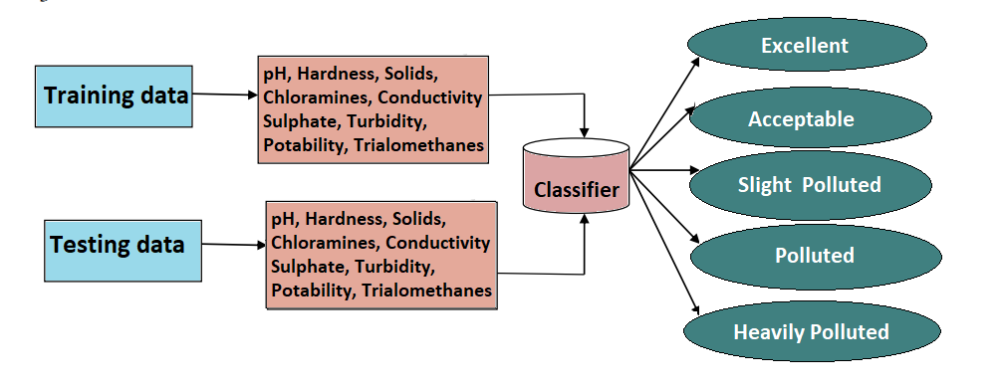
ARCHITECTURE DIAGRAM
Proposed Work
Dept. of ISE, SIT, Tumkur
15

Slide 16
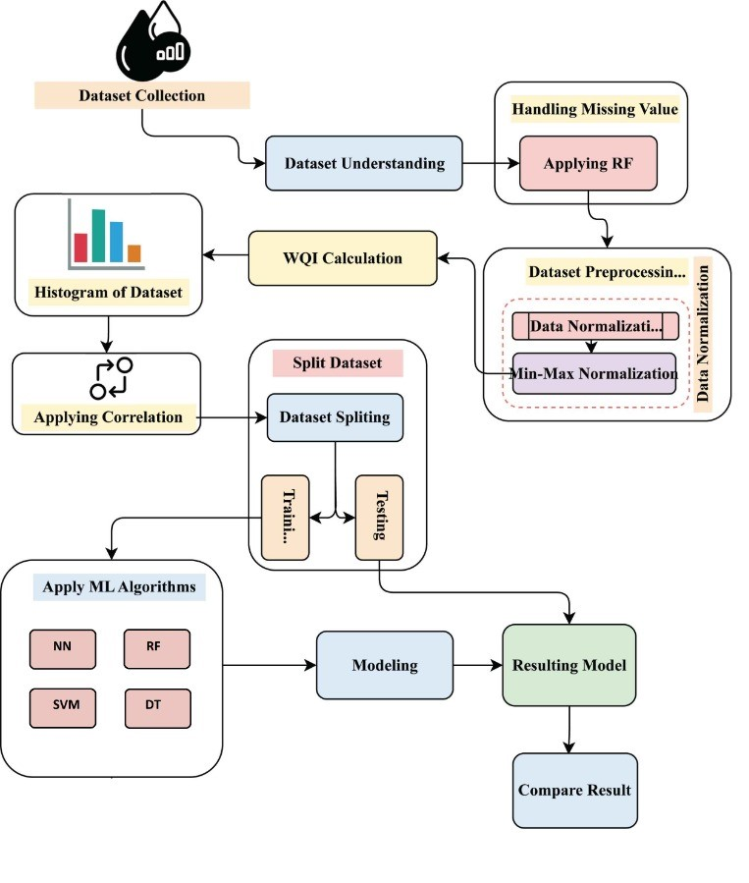
Proposed Work
FLOW DIAGRAM
Dept. of ISE, SIT, Tumkur
16

Slide 17
Requirements
REQUIREMENTS
Dataset consisting of 10 indicator parameters extracted from Kaggle.
Python libraries such as pandas, matplotlib, NumPy, scikit-learn .
Flask Framework for Server Connectivity.
Languages used:
Front-end | Back-end
HTML, CSS, JavaScript | Python
Dept. of ISE, SIT, Tumkur
17

Slide 18
APPLICATIONS
Applications
It can be used in the agricultural sector.
It can be used in determination of drinking water quality.
It can be used in solar module cleaning.
It can be used in sterilization of instruments as well as in injections.
It can be used in laboratory examinations.
It can be used in manufacturing industries.
It can be used in hydroponics
Dept. of ISE, SIT, Tumkur

Slide 19
CONCLUSION
Conclusion
Modeling and prediction of water quality are very important for the protection of the environment and life on earth. Developing a model by using advanced Artificial Intelligence Algorithms can be used to measure the water quality index (WQI). The proposed models are evaluated and examined by some statistical parameters. After examining the robustness and efficiency of the proposed model for predicting the WQI, the developed models are implemented to predict the water quality for different types of water.
Dept. of ISE, SIT, Tumkur

Slide 20
REFERENCES
References
[1] Ahmed U, Mumtaz R, Anwar H, Shah AA, Irfan R, García-Nieto J. Efficient water quality prediction using supervised machine learning. Water. 2019 Nov;11(11):2210.
[2] Vergina SA, Kayalvizhi S, Bhavadharini RM, Kalpana Devi S. A real time water quality monitoring using machine learning algorithm. Eur J Mol Clin Med. 2020;7:2035-41.
[3] Akansha Rai, Dept. of Communication, Shri Shankaracharya Group of Institutions, Durg, C.G., Water Quality Monitoring System using Traditional lab Process India Published in: 2018
[4] Hassan MM, Hassan MM, Akter L, Rahman MM, Zaman S, Hasib KM, Jahan N, Smrity RN, Farhana J, Raihan M, Mollick S. Efficient Prediction of Water Quality Index (WQI) Using Machine Learning Algorithms. Human-Centric Intelligent Systems. 2021;1(3-4):86-97.
[5] Akkoyunlu A, Akiner me (2012) pollution evaluation in streams using water quality indices: a case study from turkey’s sapancalake basin. Ecol ind 18:501–511.[ DOI:10.1016/j.Ecolind.2011.12.018 ]
[6] Cude CG (2001) Oregon water quality index a tool for evaluating water quality management effectiveness. J am water resource association 37(1):125–137.[ DOI:10.1111/j.17521688.2001.Tb05480.X ]
[7] CV Sillberg, P Kullavanijaya, and O Chavalparit, Water quality classification by integration of attribute-realization and support vector machine for the chao phraya river, Journal of Ecological Engineering, Vol. 22, 2021, pp. 70-86.
Dept. of ISE, SIT, Tumkur

Slide 21

Thank You

